Slide 1
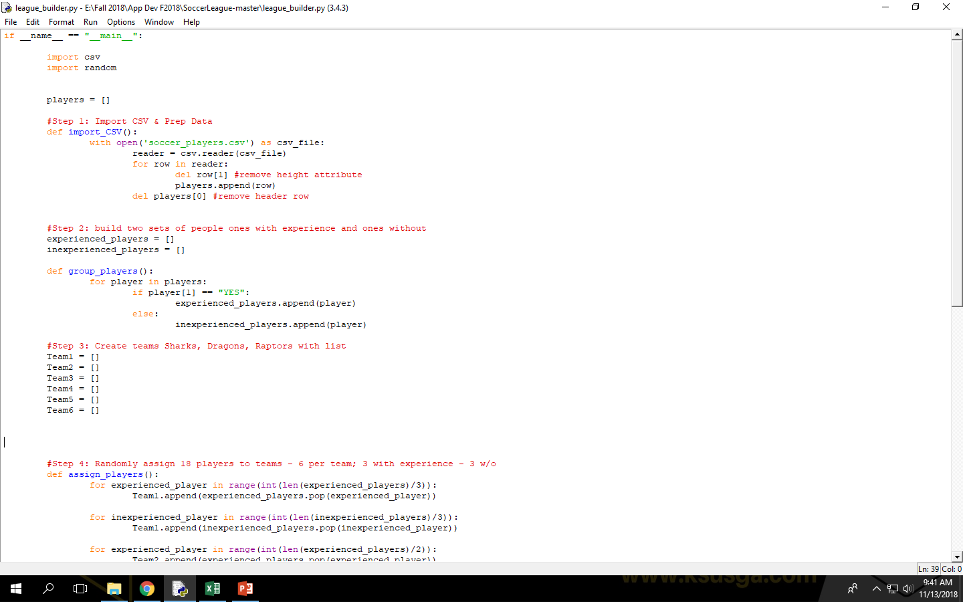
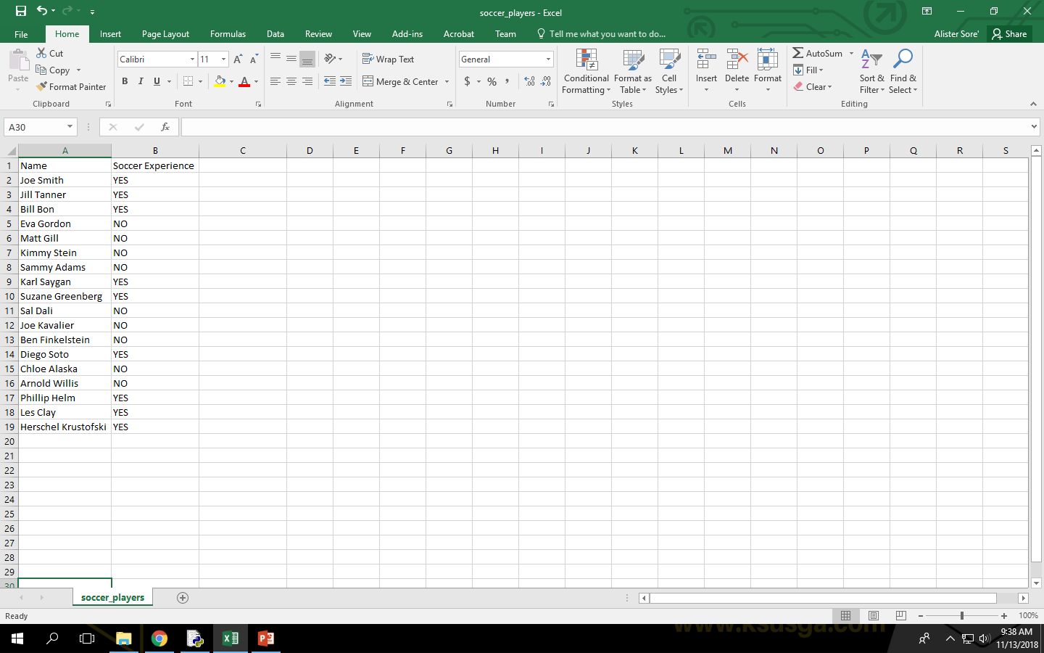

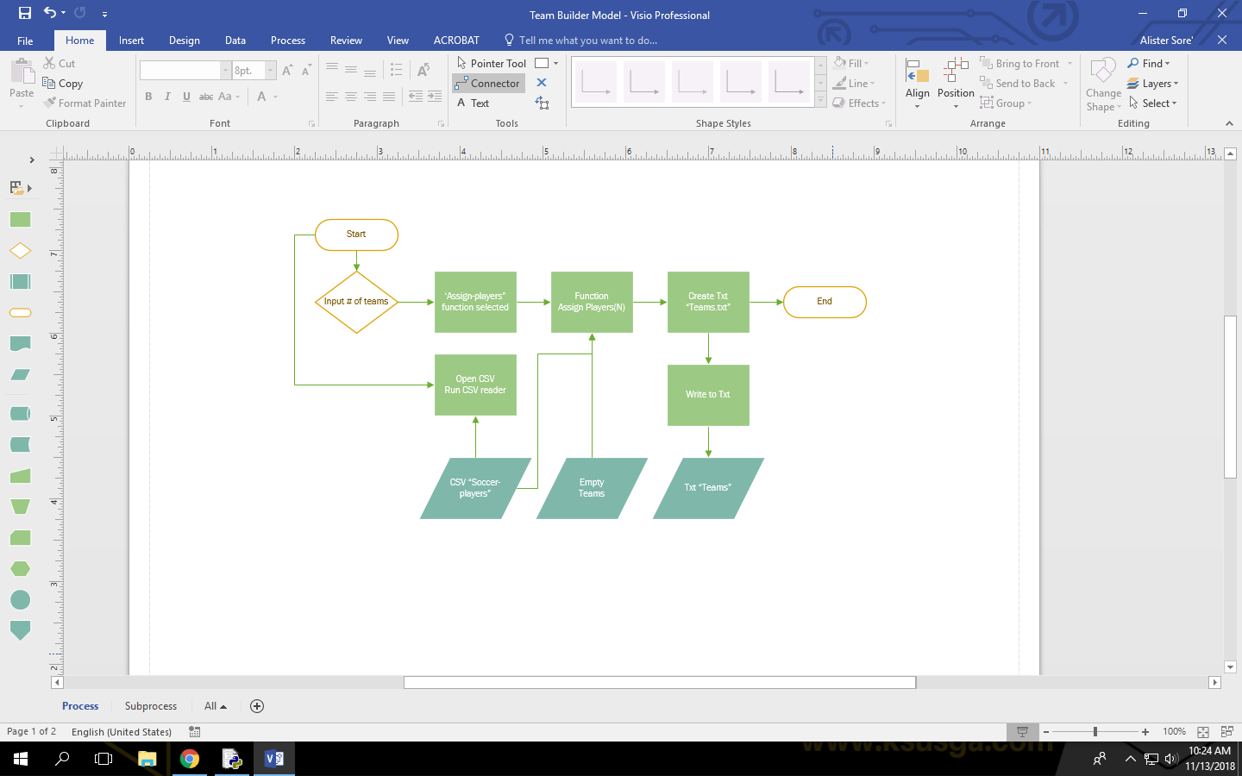
Team Builder
Manage efficient and balanced teams with the press of a button
Lead Project Designer - Alister Sore’
Associated Codebase Programs – “League Builder”(jbrashear) |“League Builder” (macbrennan90)

